Slide 1
Hiring International Talent Through H-1B Visa Sponsorship
Michael E. Durham, Partner
Barnes & Thornburg LLP
mdurham@btlaw.com
574-237-1145

Slide 2
Immigration Terms, Acronyms, & Relevant Government Agencies

Slide 3
Immigration Terms
U.S. Citizen
Birth in the U.S.
Birth abroad to U.S. citizen parent or adoption
Naturalization
Asylee & Refugee
Permission for foreign nationals to reside in the U.S.
Includes automatic employment authorization
U.S. National
All U.S. citizens are U.S. nationals
Some U.S. nationals are not U.S. citizens
American Samoa and Swains Islands
Temporary Status
Permission for temporary presence in the U.S.
May, or may not, also confer employment eligibility
U.S. Legal Resident
“Green Card”
Permanent permission to reside and work in the U.S.
Removal/Deportation possible
Undocumented
Entered U.S. without permission and those who overstayed their permission
“Illegal Alien”

Slide 4
Additional Immigration Terms & Immigration Acronyms
I-9
Employment Eligibility Verification Form
Required for all hires after November 1, 1986
Reverification may be required
EAD
“Work Card,” I-766
Temporary permission to work in the U.S.
Eligibility based on classification
Visa
Foreign nationals seeking entry into the U.S. must generally first obtain a U.S. visa, which is placed in the foreign national’s passport unless other exempt from this requirement
Green Card
Evidence of legal residency status for conditional legal residents and permanent legal residents
I-551
I-94
Entry document governing a foreign national’s stay in the U.S.
May, or may not, also confer employment eligibility
Different than a “visa” which is used to enter the U.S.
E-Verify
Web-based system that allows employers to confirm the eligibility of their employees to work in the U.S.
Does not replace I-9

Slide 5
Additional Immigration Terms & Immigration Acronyms
H-1B
Worker in a specialty occupation
Normally capped at 6 years
Some extensions possible
OPT
Optional practical training for foreign national students
One year work card
H-1B1
Worker in a specialty occupation
Citizens of Chile and Singapore
Generally available
STEM OPT
Additional OPT extension for STEM majors working for E-Verify enrolled employers with training plan
Two year work card
E-3
Worker in a specialty occupation
Citizen of Australia
Generally available
TN
Professional Worker
Canadian and Mexican citizens
Indefinite renewals possible

Slide 6
Relevant Government Agencies
U.S. Department of Homeland Security (DHS): Former INS was absorbed and split into 3 separate agencies when DHS was established in 2002
U.S. Citizenship and Immigration Services (CIS): Administrative agency which administers our immigration and naturalization system (H-1B petitions, naturalization/citizenship applications, etc.)
U.S. Customs and Border Protection (CBP): Law enforcement agency which governs our borders, enforces trade, customs, and tariffs; largest federal law enforcement agency and includes the Border Patrol
U.S. Immigration and Customs Enforcement (ICE): Law enforcement agency tasked with removal (deportation) and investigations; administers foreign student program for colleges and universities (F-1)
U.S. Department of State: Mainly involved with issuance of visas at U.S. Embassies and Consulates; also involved with some other immigration programs
U.S. Department of Labor: Mainly involved with prevailing wage determinations (H-1B, etc.) and labor certifications; protects U.S. workers

Slide 7
What is an H-1B Visa?

Slide 8
H-1B: Non-immigrant (Temporary) Employment Visa
Generally reserved for Specialty Occupations
Benefits:
- Dual intent recognized
Issues:
- Limitation on stay
- Wage requirement
- Public access file
- Increased scrutiny
- RFEs and denials
Specialty Occupation requires the theoretical and practical application of a body of highly specialized knowledge and that requires the attainment of a bachelor’s degree or higher in a specific specialty or its equivalent, as minimum for entry into the occupation in the U.S.

Slide 9
Preparing an H-1B
Initial H-1B petitions, along with transfers, and renewals are officially treated the same by USCIS – and are generally prepared in a similar manner
Review the position description to see if it appears to qualify as a specialty occupation and issue spot any concerns with minimum requirements and responsibilities; determine the appropriate occupations designations by the US Department of Labor and research the prevailing wage and determine the actual wage with the employer; compare the positon to the employee’s credentials to determine if the employee is qualified for the specialty occupation
Modifications and edits are sometimes required at this stage (to the salary, or position requirements, and duties)
Prepare the labor conditional application (posting) with the US Department of Labor and the Public Access File
After receiving a certified labor conditional application, prepare the H-1B forms for USCIS and an employer support letter and file the petition with USCIS and await a response

Slide 10
Precursor Filings for an H-1B
An employer is required to pay a salary or wage at least the higher of the prevailing wage or actual wage for the position
A precursor filing – and public posting- is required by the US Department of Labor prior to filing the H-1B petition attesting to the payment of at least the higher of the prevailing wage or actual wage for the position and notifying employees of the H-1B
An employer is required to maintain a “public access file” for inspection

Slide 11
H-1B Lottery
New H-1B petitions are sometimes subject to an annual lottery due to high demand. Of the approximately 85,000 available new visas, 20,000 are reserved for recipients of a U.S. Masters degree or higher. Generally, renewals and transfers are not subject to the lottery.
In previous years, employers had a five day window each April (the first five working days in April each year), to file an H-1B petition with USCIS. Later in the spring or summer, USCIS would hold a lottery and announce the winners (and process the petition later in the year).
In 2020, the H-1B lottery underwent a major change: for the first time, immigration implemented a registration process. Employers are required to register during a designated time period and provide preliminary information – not about the company but also about the sponsored employee. In late March, USCIS holds a lottery from the submitted registrations. Winners are notified and provided a window to file the petitions. Subsequent drawings are possible from submitted registrations.

Slide 12
H-1B Lottery Results
Fiscal Year | Total Registrations | Eligible Registrations | Eligible Registrations for Beneficiaries with No Other Eligible Registrations | Eligible Registrations for Beneficiaries with Multiple Eligible Registrations | Selections
2021 | 274,237 | 269,424 | 241,299 | 28,125 | 124,415
2022 | 308,613 | 301,447 | 211,304 | 90,143 | 131,924
2023 | 483,927 | 474,421 | 309,241 | 165,180 | 127,600
2024 | 780,884 | 758,994 | 350,103 | 408,891 | 188,400 (Initially 110,791)

Slide 13
H-1B Extensions
An H-1B may be issued for period of up-to 3 years. A renewal or extension may be possible; however, there is generally a 6 year cap for H-1Bs. After 6 years, the employee would need to leave the U.S. for one year in order to be eligible for another H-1B cycle.
Extensions beyond the 6 year cap may be available in two scenarios:
-If the employee has an approved labor certification and an I-140 petition, and their priority date is not current (an immigrant visa number is not available for them), an employer may request to extend the employee’s H-1B in 3 year increments beyond the 6 year cap. This scenario often impacts Indian and Chinese national employees due to Visa Bulletin wait lists for EB-2 and EB-3 classifications.
-If an employer has filed the labor certification on behalf of the employee at least one year prior to their 6 year cap and if the case is still pending (they have not received legal residency), the employer may sponsor the employee for a 1 year extension of the H-1B beyond the 6 year cap.

Slide 14
H-1B Transfers
Timeframe for H-1B transfers – generally, at least one month advance notice
New employee may onboard only after USCIS has received the request to port “transfer” the H-1B; evidenced either with a “receipt notice” from USCIS or evidence of delivery and receipt of the H-1B petition by USCIS
New employee should continue working for employer until able to transfer
There is a cumulative 60 day grace period for unemployment

Slide 15
Common Issues for H-1B Petitions
Employer’s position description is too vague to substantiate that the position is a specialty occupation
Employer requires more from applicants in terms of education or experience than allowed as per norms stated by US Department of Labor for occupational classification
Employer’s salary is too low for visa sponsorship per prevailing wage data maintained by the U.S. Department of Labor
Employee does not possess the required minimum qualifications per U.S. Department of Labor data
Evidence is lacking to verify that the employee maintained lawful status in the U.S. (copy of all I-20s from school, copy of all academic credentials and immigration documents, and copy of all paystubs for current year and all W-2s for previous years)

Slide 16
H-1B Employee Rights
H-1B employees generally hold the same rights as other employees
One significant protection for H-1B employees is that of a required wage (higher of the prevailing wage or actual wage) and the prohibition on allowing the employee to pay or reimburse certain fees and costs related to the H-1B process
One additional protection exists for H-1B employees - if an employer terminates an H-1B employee prior to the end date on their visa sponsorship, the employer must generally offer the employee an airline ticket home, or the cost of return transportation back to their home country

Slide 17
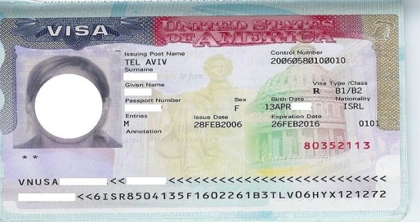
Options to the H-1B: Additional Temporary Visas Classifications for Employees and Prospective Hires

Slide 18
F-1 Student
F-1 students may obtain permission to work off campus pursuant to a grant of curricular practical training, or optional practical training
Upon graduation, F-1 students are generally entitled to obtain one year of optional practical training employment authorization and STEM students are sometimes eligible to request an additional two years of employment authorization
Benefits:
- Low cost
- Ease
Issues:
- Temporary
- Documents for I-9
- DSO/SEVIS/ICE
- USCIS/EAD
- STEM training plan

Slide 19
H-1B1 Visa
Similar to H-1B Visa
Benefits:
- No limitation on stay
- Less documentation
Issues:
- Temporary employment
- Prevailing wage
- No dual intent
Reserved for citizens of Chile and Singapore
May apply directly with USCIS or Consulate
Generally more reliable, faster and less expensive than H-1B

Slide 20
E-3 Visa for Australians
Benefits:
- No limitation on stay
- Less documentation
Issues:
- Temporary employment
- Prevailing wage
- Annual quota
- No dual intent
Similar to H-1B Visa
Reserved for citizens of Australia
May apply directly with USCIS or Consulate
Generally more reliable, faster and less expensive than H-1B

Slide 21
TN NAFTA/USMCA Visa
Professional Occupations – NAFTA List
Benefits:
- No limitation on stay
- No prevailing wage
Issues:
- Temporary employment
- No dual intent
- New USMCA
Reserved for citizens of Canada and Mexico
May apply directly with USCIS, Consulate (Mexicans), or with USCBP (Canadians)
Generally more reliable, faster and less expensive than H-1B

Slide 22
O-1 Extraordinary Ability
Generally reserved for foreign nationals shown to have extraordinary ability in the sciences, arts, education, business, or athletics
Prospective employees who possess substantial prior experience may be eligible for this classification
The position does not require someone of O-1 caliber
Benefits:
- Dual intent
- No prevailing wage
Issues:
- Limitation on stay
- Documentation
- Increased scrutiny
- RFEs and Denials

Slide 23
E Visa Treaty Traders & Investors
Benefits:
- No limitation on stay
- Less documentation
Issues:
- Temporary employment
- Qualifying country
- Qualifying nationality
- Qualifying employment
Reserved for citizens of countries with specific treaties with the U.S.
Substantial investment or substantial trade required
May apply directly with USCIS or Consulate
Generally more reliable, faster and less expensive than H-1B

Slide 24
B-1 Business Visitor
Visitors engaging in commercial transactions not involving gainful employment: negotiating contracts; litigation; consulting with clients; attending conferences, conventions, or meetings; and trainings.
Initial admission is generally limited to 6 months
Clear intent to continue foreign residence
Benefits:
- Low cost
- Ease
- VWP/ESTA
- B-1 in lieu of H-1
Issues:
- Temporary
- No salary

Slide 25
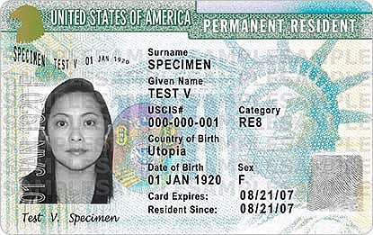
Immigrant Visas - Permanent Sponsorship for Employees and Prospective Hires - a Path to Legal Residency

Slide 26
Common Immigrant Preference Categories
EB−1 Priority Workers−foreign nationals with extraordinary abilities in field of endeavor, and multinational managers and executives.
EB−2 Professionals holding advanced degrees or equivalent, or persons of exceptional ability in the arts, sciences, or business.
EB-2 NIW: National Interest Waiver
Request to waive labor certification because it is in the interest of the U.S.
-The proposed endeavor has both substantial merit and national importance;
-You are well positioned to advance the proposed endeavor; and
-On balance, it would be beneficial to the U.S. to waive the requirements of a job offer, and thus the labor certification
EB−3 Professionals holding baccalaureate degrees, skilled workers, and other workers

Slide 27
Labor Certification PERM
Department of Labor process governing foreign labor sponsorship
Generally requires evidence that there are no minimally qualified and available U.S. workers
Extensive documentation of recruitment activities to include advertisements, job postings, and state job order
Normally does not allow for requirement of any skills or experience gained by the foreign national while employed with the petitioning employer
Prevailing wage requirement

Slide 29
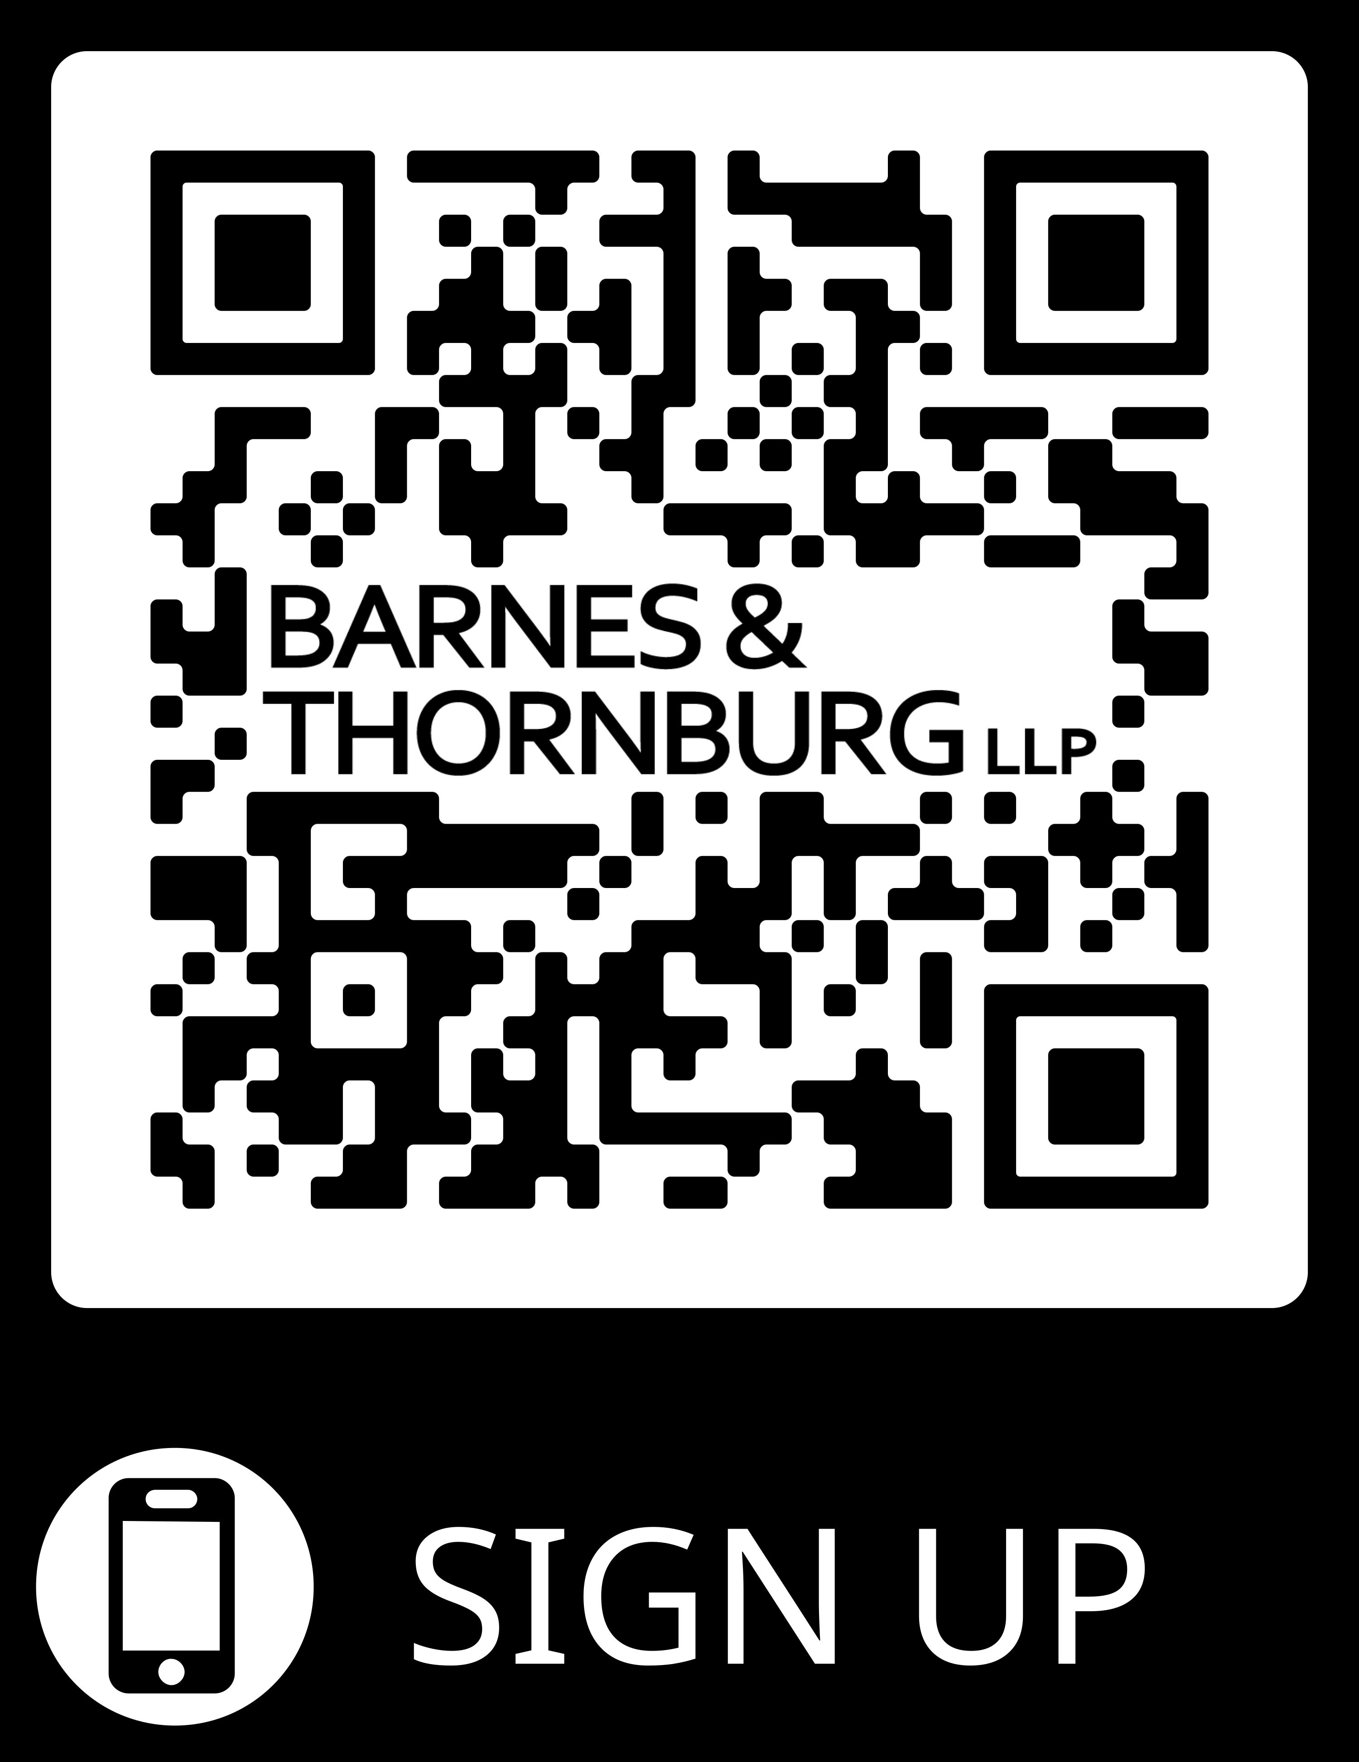
Subscription Center

Slide 30
ACKNOWLEDGMENT & DISCLAIMER
These materials were prepared by the attorneys at the law firm of Barnes & Thornburg LLP. These materials present general information about state law and federal law, and they only serve as a beginning point for further investigation and study of the law relating to these topics. Although these materials present and discuss labor and employment law issues, they are not intended to provide legal advice. Legal advice may be given and relied upon only on the basis of specific facts presented by a client to an attorney. Barnes & Thornburg LLP and the authors of these materials hereby disclaim any liability which may result from reliance on the information contained in these materials.

