Slide 1
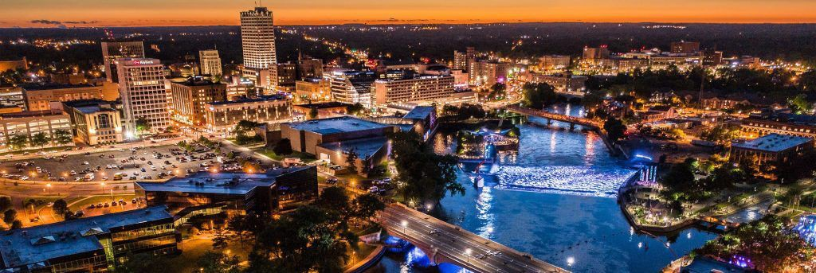
Creating Qualified Opportunity Zone Funds
Structure, Certification, and Maintenance March 29, 2019
Jim Champer
574.289.4011
jchamper@klcpas.com
Matt Deputy
574.968.0760
mdeputy@southbank.legal
George Cressy, III
574.310.8237
gcressy@southbank.legal

Slide 2
What Is a Qualified Opportunity Fund
A QOF is the legal entity through which an investor re-invests their capital gain within 180 days of the gain realization event.
The QOF then invests in Qualified Opportunity Zone Property.
Direct Structure
QOF owns 100% of a trade or business and its assets
“Single-tier” Structure (one tax return)
Indirect Structure
QOF owns a partial interest in a lower tier entity (either QOZ stock or QOZ partnership interest)
“Two-tier” Structure (at least 2 tax returns)

Slide 3
Eligible Investors, QOFs, and Investments
Who can Invest?
Investors in a QOF may be just about anyone
Individuals, trusts, estates, REITs, general partnerships, corps, and LLCs
Not another QOF
The capital gains funding the investment must be for equity in the QOF entity for income-tax purposes
Preferred equity is OK
Partnership interests entitled to special allocations, such as cashflow or liquidation preferences, are OK

Slide 4
Eligible Investors, QOFs, and Investments
What type of entities can become a QOF?
New QOF Entity Types:
QOFs may be a multi-member LLC, Partnership, or Corporation organized for the purpose of investing in QOFs
taking an s-election with the IRS appears to be OK, but the Proposed Regs are silent
Pre-Existing Entities
A pre-existing entity that would qualify as a new entity can elect to be a QOF
Regs allow a QOF: (i) to identify the taxable year in which the entity becomes a QOF and (ii) to choose the first month within that year to be treated as a QOF

Slide 5
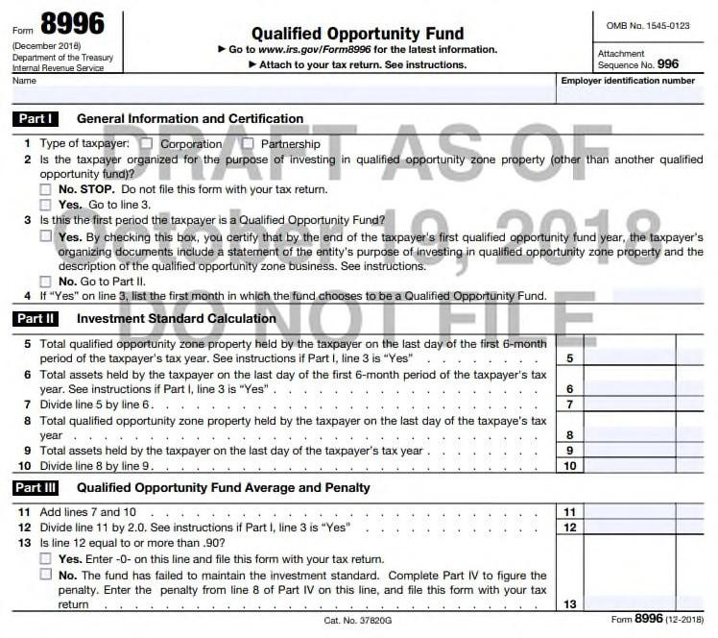
Eligible Investors, QOFs, and Investments
Corporations, LLCs, and partnerships can
self-certify that they meet
the requirements to be treated as QOFs
IRS released Form 8996 with the proposed regs
Entities that desire to be treated as QOFs must include Form 8996 with their tax returns

Slide 6
The 90% Test
A QOF must hold ≥90% of its assets in QOZ Property:
QOZ Stock: newly issued stock of a corporation
QOZ Partnership Interest: newly issued partnership interests
QOZ Business Property: tangible business property in a QOZ
Tested 2x Per Year
Average of percentage of QOZ Property held in QOF on:
last day of the first 6-month period (June 30)
last day of QOF’s tax year (December 31)
Ex:
June 30: 85% of assets are QOZ Property
Dec. 31: 97% of assets are QOZ Property
Pass: average = 91%
In cases #1 and #2, the company must be a QOZ Business

Slide 7
The 90% Test
Note: For Pre-Existing Entity
Only assets acquired by a pre-existing entity after 12/31/17 count towards the requirement that 90% Test (QOZ Property)
Difficult to pass 90% Test if pre-existing entity has material pre-2018 assets

Slide 8
QOZ Business
70% Test: tangible property owned or leased by the QOZ Business is QOZ Business Property
Combined with 90% Test, the “indirect” structure = 63% Test
≥50% total gross income of QOZ Business is derived from the “active conduct” of such business
Cloud regarding net leases
Not a “Sin Business”:
golf course, country club, massage parlor, hot tub facility, suntan facility, racetrack, casino, or liquor store

Slide 9
QOZ Business Property
Tangible property used in trade or business (e.g., equipment, real estate)
Acquired after December 31, 2017
“Original Use” or “Substantial Improvement”
Original Use of the property within the QOZ begins with business
Note: can be used property from outside the QOZ
Substantially Improved
200% Test—excluding land
30 Months
Not acquired from a Related Party (20%)
Remains within the QOZ

Slide 10
Example 1 of “Substantial Improvement”
A QOF buys an existing commercial building for $10 million on March 1, 2019
$2 million is attributable to the land
$8 million is attributable to the structure
QOF rehabs the building over 30 months, spending at least $8 million
Appears that the building will satisfy the substantial- improvement requirement and thus be QOZ Business Property

Slide 11
Example 2 of “Substantial Improvement”
A QOF buys a used piece of used machinery from within the QOZ for $100,000 on March 1, 2019
QOF rehabs the machinery over 30 months, spending at least
$100,000
Appears that the machinery will satisfy the substantial- improvement requirement and thus be QOZ Business Property
Note: The 31-month working-capital safe harbor only applies to QOZ Businesses, so unclear how the unused cash and the currently-being-improved machinery will be treated for the 90% Test.

Slide 12
Example 1 of “Original Use”
A QOZ Business buys a used piece of machinery from outside
the QOZ for $200,000 on March 1, 2019
QOZ Business brings the machinery into the QOZ, uses it in its business, and keeps it within the QOZ
Appears that the machinery will satisfy the original-use requirement and thus be QOZ Business Property
Even though no rehab

Slide 13
Example 2 of “Original Use”
A QOZ Business buys a new piece of machinery from within the QOZ for $1 million on March 1, 2019
QOZ Business keeps the machinery in the QOZ and uses it in its business
Appears that the machinery will satisfy the original-use requirement and thus be QOZ Business Property

Slide 14
Example 3 of “Original Use”
QOZ Business buys vacant land for $1 million on March 1, 2019
QOZ Business builds a new building for $8 million
Appears that the building will satisfy the original-use requirement and thus be QOZ Business Property
But, the land cannot satisfy the original-use requirement, and thus it is not QOZ Business Property
– It’s unclear whether the $1m value of the land counts against the 70% or 90% Test
If these were the only assets:
QOZ Business passes 70% Test: 88.9% > 70%
QOF fails 90% Test: 88.9% < 90%

Slide 15
Summary: Steps of a QOZ Investment
Investors identify realized (or realizable) capital gains
Self-certify an entity as a QOF
Invest deferred eligible capital gains into QOF (equity)
QOF acquires QOZ Property solely in exchange for cash
QOF/QOZ Business either:
acquires tangible property and commences its original use within the QOZ; or
acquires and substantially improves tangible property
Semi-annual asset tests (90% and possibly 70%)
Step up basis of deferred capital gains (Step 3) in Years 5 & 7
Step up basis of QOF investment (Year 10)

Slide 16
Questions/Discussion

Slide 17
The information provided in this presentation does not, and is not intended to, constitute accounting, tax, or legal advice; instead, all information and content are for general informational purposes only. Information in this presentation may not constitute the most up-to-date accounting, tax, legal, or other information.
Readers of this presentation should contact their attorney to obtain advice with respect to any particular matter. No reader should act or refrain from acting on the basis of information in this presentation without first seeking accounting, tax, or legal advice. Use of and access to this presentation do not create an attorney-client relationship between the reader the authors. The views expressed are those of the individual authors writing in their individual capacities only. All liability with respect to actions taken or not taken based on the contents of this presentation are hereby expressly disclaimed. The content in this presentation is provided “as is”; no representations are made that the content is error-free.
Jim Champer
574.289.4011
jchamper@klcpas.com
Matt Deputy
574.968.0760
mdeputy@southbank.legal
George Cressy, III
574.310.8237
gcressy@southbank.legal

