Slide 1
Department of Code Enforcement
Tracy Skibins,
Director of Code Enforcement
Pete Buttigieg,
Mayor of South Bend

Slide 2
Be A Good Neighbor
Part of being a good neighbor is properly maintaining your home and property.
Simple things like touching up peeling paint, keeping your yard mowed, picking up trash and keeping your bushes trimmed will all have a huge impact on your neighborhood!
Lead by example! No one wants to be the “dirty” neighbor!
For those neighbors that don’t catch on, the Department of Code Enforcement is here to help!

Slide 3
Your Code Enforcement Team
● 1 Director
● 1 Deputy Director
● 10 Full-Time Inspectors
● 1 Part-Time Inspector
● 6 Office Staff Members
● 1 Part-Time Office Staff Member

Slide 4
Primary Violation Categories
Environmental
Housing
Zoning

Slide 5
Environmental Citation Procedure
Each inspector drives his or her designated inspection area, cites new violations and responds to citizen complaints.
For all confirmed violations, the property owner is notified and given 10 days to clean the property.
After the 10 day period, the inspector reinspects the property.
If the property has been cleaned, the case is closed.
If the property is still in violation, the case is sent to the Neighborhood Enforcement Action Team to abate.
Code Enforcement will then bill the property owner for the cleanup performed.

Slide 6
Types of Environmental Cases
Environmental citations can be grouped into five primary categories:
Litter (40.6% of violations in 2014) – trash, illegal dumping, appliances, tires, demolition remains, etc.
Tall grass and/or weeds (33.9% of violations in 2014)
Vegetation – Fallen tree limbs/branches, cut brush, vegetation overgrowth, yard waste, etc.
Graffiti
Snow

Slide 7
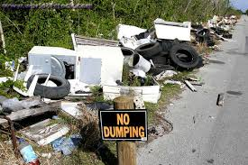
Environmental: Litter and Illegal Dumping Violations

Slide 8
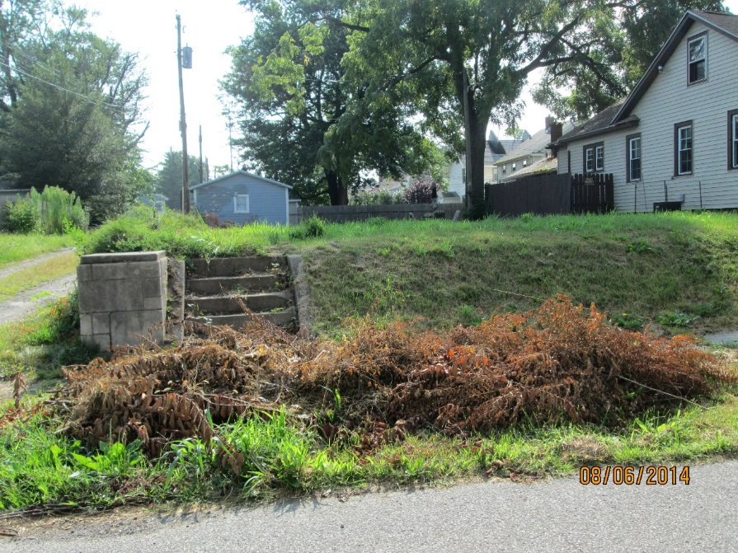
Environmental: Tall Grass and Weeds / Yard Waste: Violations

Slide 9
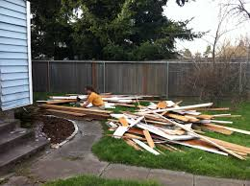
Environmental: Demolition Remains

Slide 10
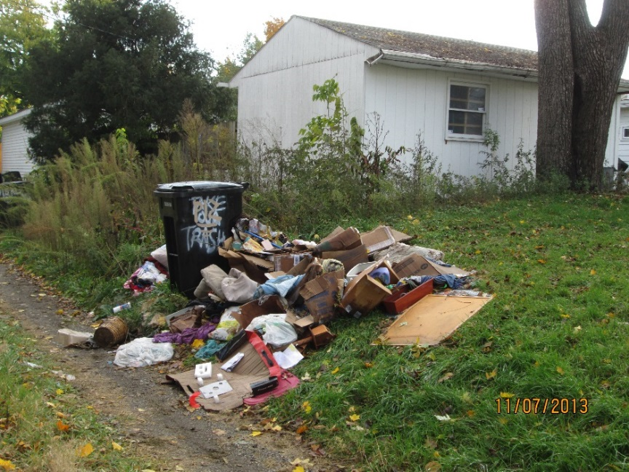
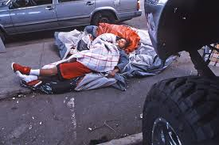
Environmental: Obstruction of Traffic

Slide 11
Environmental: Is this a Violation?
NO!
Overgrown shrubs are not a violation, unless they obstruct public
right-of-way

Slide 12
Environmental: Is this a violation?
YES!
This is a violation of municipal code 16-53

Slide 13
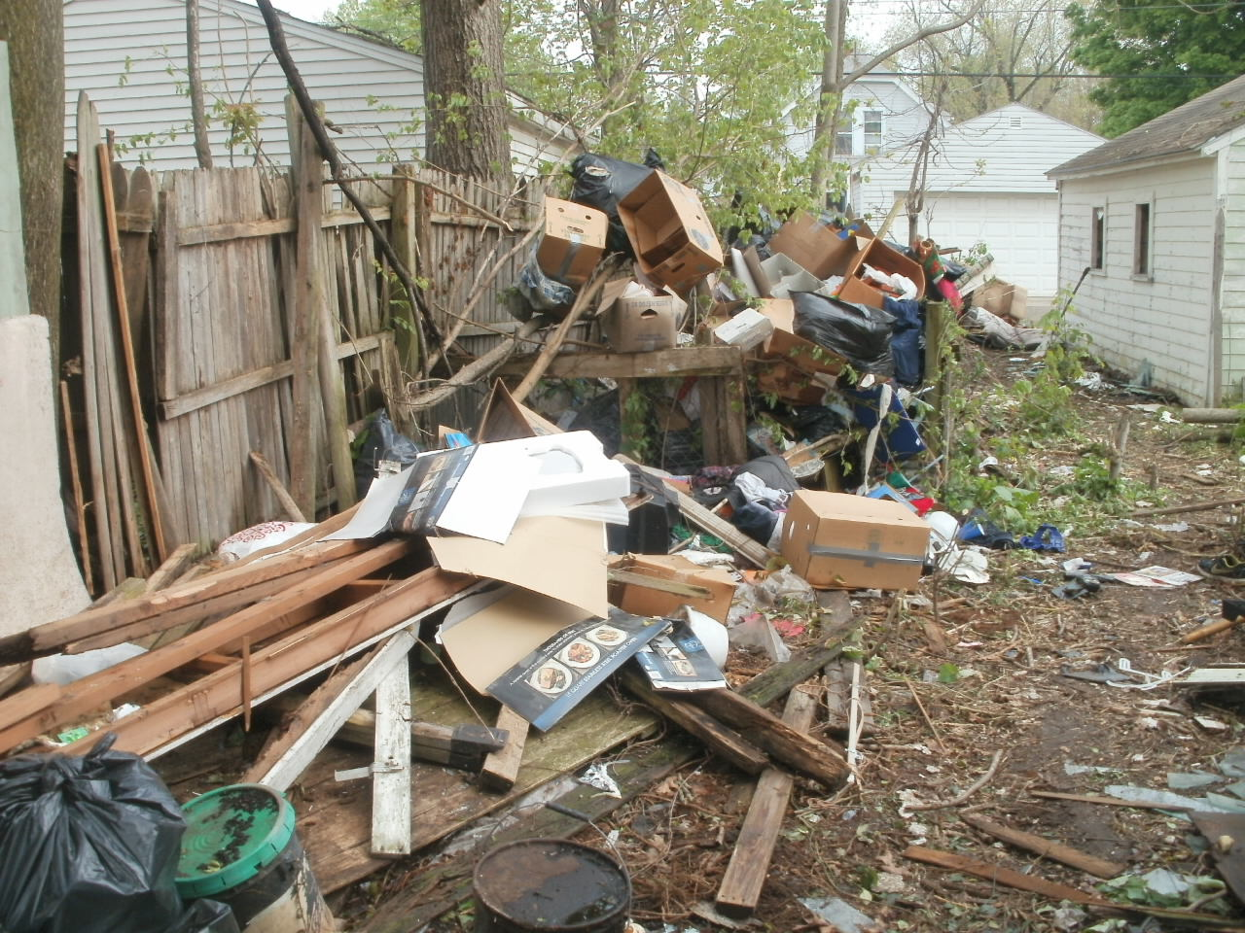
Neighborhood Enforcement Action Team Cleanup
BEFORE

Slide 14
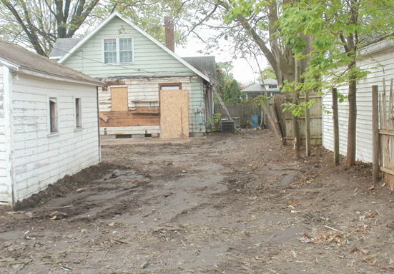
Neighborhood Enforcement Action Team Cleanup
AFTER

Slide 15
Types of Housing Cases
Housing violations can be grouped into three primary categories:
Board and Secure
Housing Repair
Demolition

Slide 16
Housing Citation Procedure
Each inspector drives his or her designated inspection area, cites new violations and responds to citizen complaints.
For all confirmed violations, the property owner is notified and given between 24 hours and 30 days to repair the property.
After the allotted time period, the inspector reinspects the property.
If the property has been repaired, the case is closed.
If the property is still in violation, the case is prepared for a Code Enforcement Hearing.
The property is reinspected every 30 days until verified repaired or demolished.
Code Enforcement may issue tickets and/or impose civil penalties to non compliant owners.

Slide 17
Housing: Substandard House Exterior
Siding
Roof/ Drainage System
Windows and Doors

Slide 18
Housing: Substandard House Exterior
Chimney
Foundation
Porch

Slide 19
Housing: Substandard House Interior
Electrical System
Plumbing Fixtures
Surface Areas
Fuse panels, receptacles, lights, covers
Toilets, sinks, tubs, faucets
Windows, doors, walls, ceilings, floors

Slide 20
Housing: Substandard House Interior
Heating System
Smoke Detection
Sanitary Drainage
Every dwelling must be capable of maintaining a room temperature of 65 degrees F.
Smoke detection equipment shall be installed in all dwelling units

Slide 21
Housing: Substandard House Accessories
Retaining Wall
Fence
Garage / Shed

Slide 22
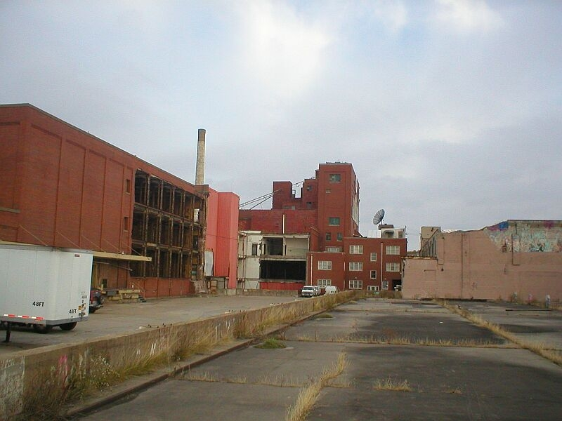
Housing: Substandard Commercial Structure

Slide 23
Housing: Residential / Commercial Demolition(s)

Slide 24
Question: What is the temperature requirement for a home’s cooling system?
Answer:
None! A cooling system is not required.

Slide 25
Zoning Citation Procedure
Each inspector drives his or her designated inspection area, cites new violations and responds to citizen complaints.
For all confirmed violations, the property/vehicle owner is notified and given between 48 hours and 10 days to remedy the situation.
After the allotted time has passed, the inspector reinspects the property/vehicle.
If the violation is no longer present, the case is closed.
If the violation is still present, a ticket may be issued and/or car may be towed.

Slide 26
Types of Zoning Cases
Zoning citations can be grouped into 2 primary categories:
Abandoned Vehicle –
Left on public property without being moved for 72 hours
Left on private property without being moved for 48 hours
Causing an obstruction to a public right-of-way
Inoperable / dismantled vehicles left on private or public property
Parcel Misuse – ex: Basketball hoop on public right-of-way, home occupation, stagnant water, unauthorized motorized vehicle parking/storage, etc.

Slide 27
Abandoned Vehicle
Obstruction –
blocking the sidewalk
Inoperable Vehicle –
on private property
Inoperable Vehicle –
on public property

Slide 28
Zoning Violations
Home Occupations
Occupancy
Garage Sales

Slide 29
Zoning Violations
Oversized Vehicles
Campers & Trailers
Parking Violations

Slide 30
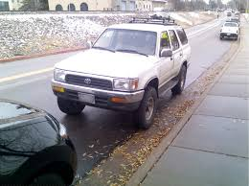
Zoning: Is This a Violation?
YES! The white vehicle is parked facing the wrong direction.

Slide 31
Helpful Tips
Call 311 with questions and to schedule special pick-ups. You are entitled to one free large trash pick-up per month.
Don’t place large items outside more than 24 hours ahead of its scheduled pick-up.
On trash day, place trash can(s) in designated pick-up location and promptly remove it after pick-up has occurred.
Loose bags of trash should always be placed in containers with lids. The city will not accept trash placed in recycling containers.

Slide 32
How to Contact Us
Online: https://southbendin.gov/department/code-enforcement/
On the Phone: 311
In Person: 1300 County-City Building, 227 W Jefferson Blvd, South Bend, IN 46601
Hours: 8am – 4:45pm

